Slide 1
Parallel Programming Design Term Project
Approach of exponential

Slide 2
目錄
01
02
03
04
05
06
Introduction
Code
CPU version
GPU version
Result
Comparison

Slide 3
01
Introduction

Slide 4
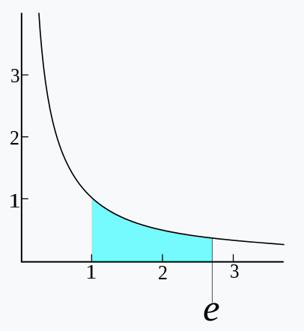






Euler’s number $e$
$$e=2.71828182845904523536…$$
$$e= \lim_{n→∞}{{\left(1+\frac{1}{n}\right)}^{n}}$$
$e= \sum_{n=0}^{∞}{\frac{1}{n!}}=\frac{1}{0!} + \frac{1}{1!} + \frac{1}{2!} + \frac{1}{3!}+ \frac{1}{4!}$ + …
$$e^{x}= \lim_{n→∞}{{\left(1+\frac{x}{n}\right)}^{n}}$$
$e^{x}=1+ \sum_{n=1}^{∞}{\frac{x^{n}}{n!}}=1+x+ \frac{x^{2}}{2!}+ \frac{x^{3}}{3!}+ \frac{x^{4}}{4!}$ + …

Slide 5
02
Code

Slide 6
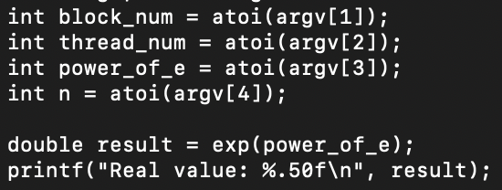

Slide 7
03
CPU version

Slide 8
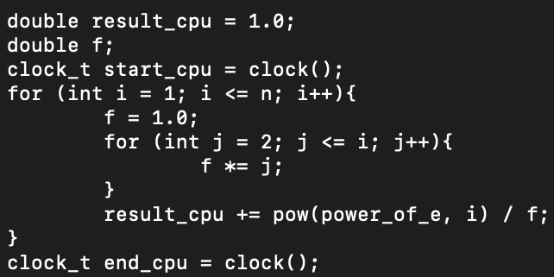

factorial
$e^{x}=1+ \sum_{n=1}^{∞}{\frac{x^{n}}{n!}}=1+x+ \frac{x^{2}}{2!}+ \frac{x^{3}}{3!}+ \frac{x^{4}}{4!}$ + …

Slide 9
04
GPU version

Slide 10
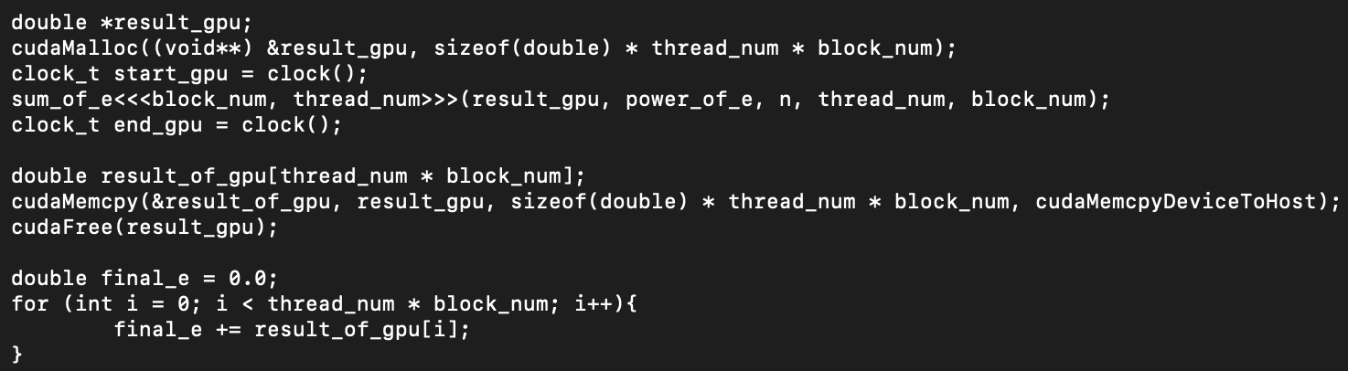

Slide 11
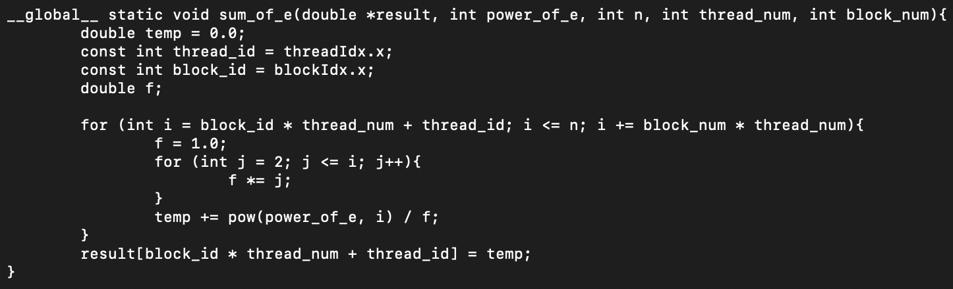

factorial
$e^{x}=1+ \sum_{n=1}^{∞}{\frac{x^{n}}{n!}}=1+x+ \frac{x^{2}}{2!}+ \frac{x^{3}}{3!}+ \frac{x^{4}}{4!}$ + …

Slide 12
05
Result

Slide 13
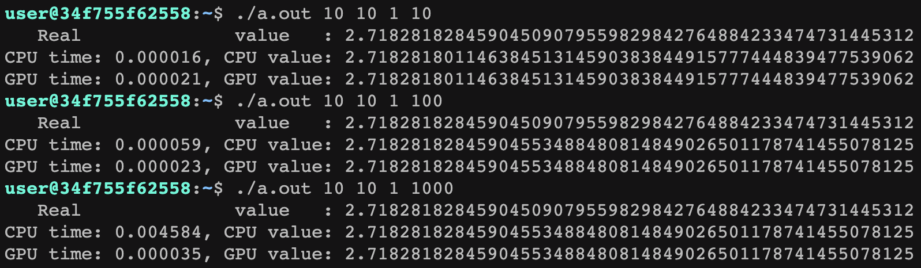

Number of block：10
Number of thread：10
Power of e：1
Number of n：1 -> 10 -> 1000
N | CPU time | GPU time | Speedup
1 | 0.000016 | 0.000021 | 0.761904
2 | 0.000059 | 0.000023 | 2.565217
3 | 0.004584 | 0.000035 | 130.971428
$e^{x}=1+ \sum_{n=1}^{∞}{\frac{x^{n}}{n!}}=1+x+ \frac{x^{2}}{2!}+ \frac{x^{3}}{3!}+ \frac{x^{4}}{4!}$ + …

Slide 14
06
Comparison

Slide 16
Thanks!

